Slide 1



USER CENTRIC EXPLAINABLE ANOMALY DETECTION IN GRAPH BASED DATABASE SYSTEMS
Abijeet Rajasekaran

Slide 2
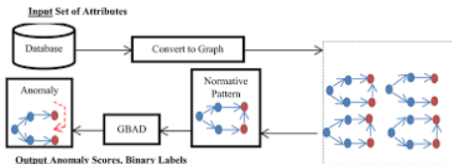

MOTIVATION AND PROBLEM STATEMENT
Anomaly detection is of two main types:
Traditional (Naive) Systems: Methods that rely on purely on statistics, fail to capture the complex nature of modern datasets.
GADs: Pre-existing GADs use structural properties to identify deviations. However they are black box and cannot be verified by analysts.

Slide 3

INTRODUCTION AND NOVELTY
Our novelty lies in creating an explanatory module for the exact feature list of the GMLs.
This bridges the black box gap left by GAD black box and plausible errors.
Generates a human readable report and verifies spotter values as well as exceptions.
Proposes a hybrid approach of combining a spotter (ML model) with a detective (explanatory module).

Slide 4
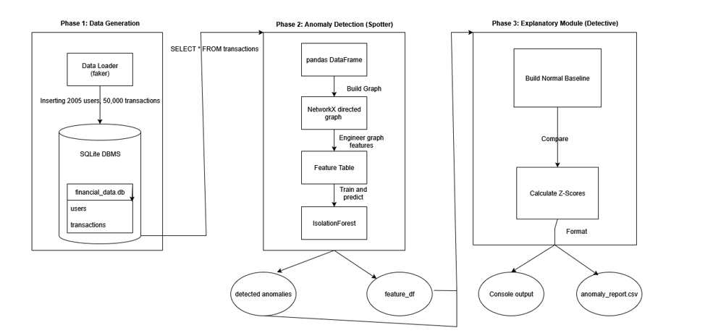
PROPOSED ARCHITECTURE

Slide 5
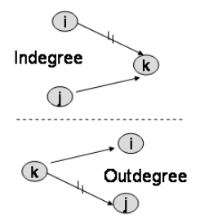
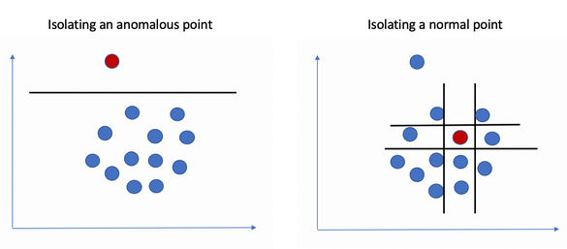
METHODOLOGY
Features are:
in_degree
out_degree
total_amount_received
total_amount_sent
Z-SCORE = (ANOMALOUS_VALUE - NORMAL_MEAN) / NORMAL_STANDARD_DEVIATION

Slide 6
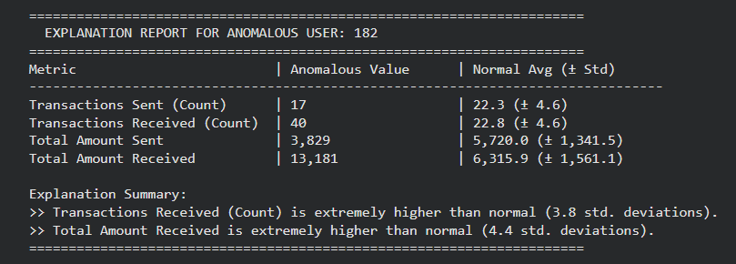
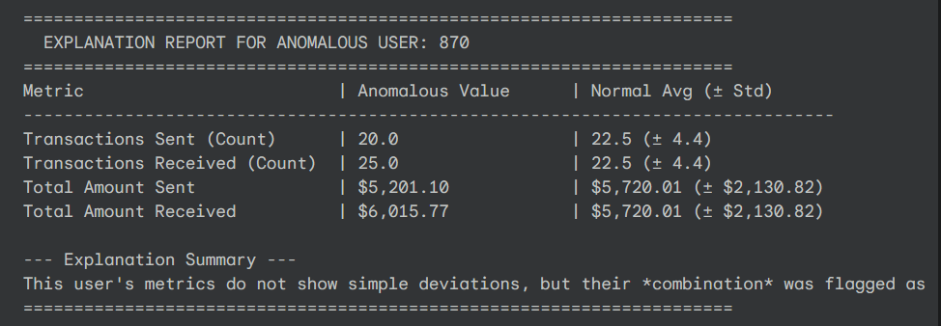
RESULTS AND DISCUSSION
Category 1: True Positives
Category 2: Ambiguous Positives

Slide 7
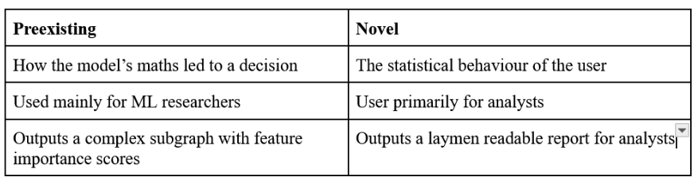
COMPARATIVE ANALYSIS
Model agnostic
Hybrid of naive and preexisting GADs, bridging both cons.
GNNExplainer:

Slide 8
THANK
YOU

